Slide 1
Wireless Packet Loss Rate
Xiangzhou Chen
Zhihan Xia

Slide 2
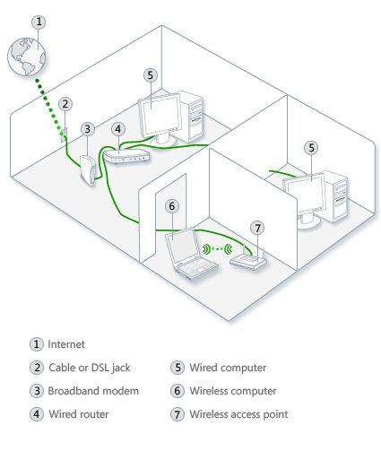
Objectives
Tools to measure wireless network RSSI and factors of influence on RSSI.
Packet loss measurement tools and analysis on data.

Slide 3
RSSI Mesurement Tools
Airport command line utility
Mac os x built-in diagnostics tools (discover all visible wireless APs and show their RSSI)
NetSpot(AP scan: detect RSSI of different locations within an area, find AP locations)

Slide 4
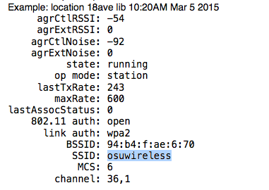
TERMINAL
Command:
/System/Library/PrivateFrameworks/Apple80211.framework/Versions/A/Resources/airport -I en1
SSID: Service set ID
BSSID: Basic sevice set ID
ESSID: Extended service set ID

Slide 5
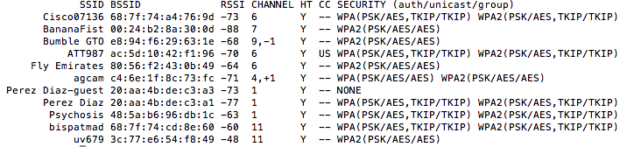
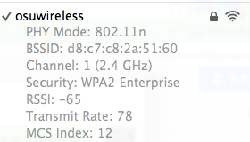
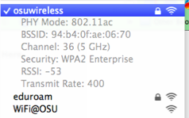
scan the airwaves for other Wi-Fi signals to connect to
Command:/System/Library/PrivateFrameworks/Apple80211.framework/Versions/Current/Resources/airport -s
HT- High Throughput
SECURITY - key management (WPA, WPA2)
Auth - (PSK or 802.1x [i.e. EAP])
Unicast - Unicast key (AES or TKIP)
Group - group key (AES or TKIP)
Figures: Upper is access point lists. Left is osuwireless in DL 517. Right is in 18 ave 4F.

Slide 6
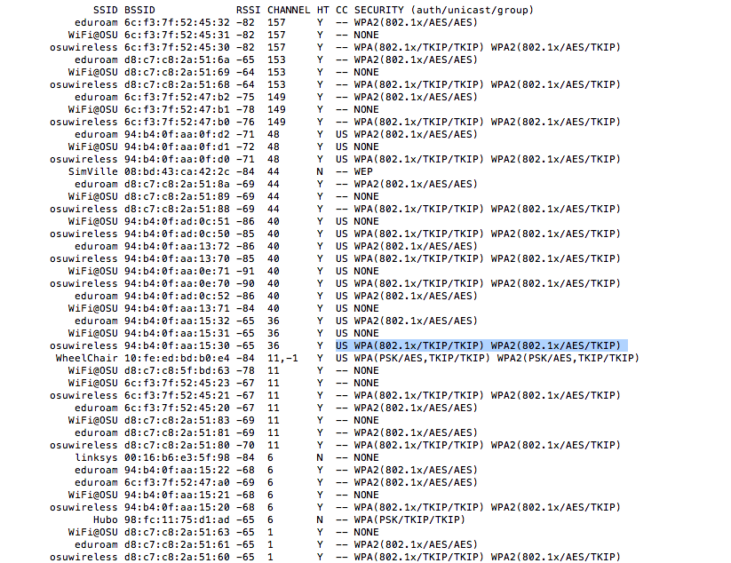
One AP may have more than one BSSIDs. For example, if one AP have 2 radio and 32 WLANs. It will have 64 BSSID plus its basic BSSID.
From the figure, guess there are 4 AP detected in 18ave 4th floor.

Slide 7
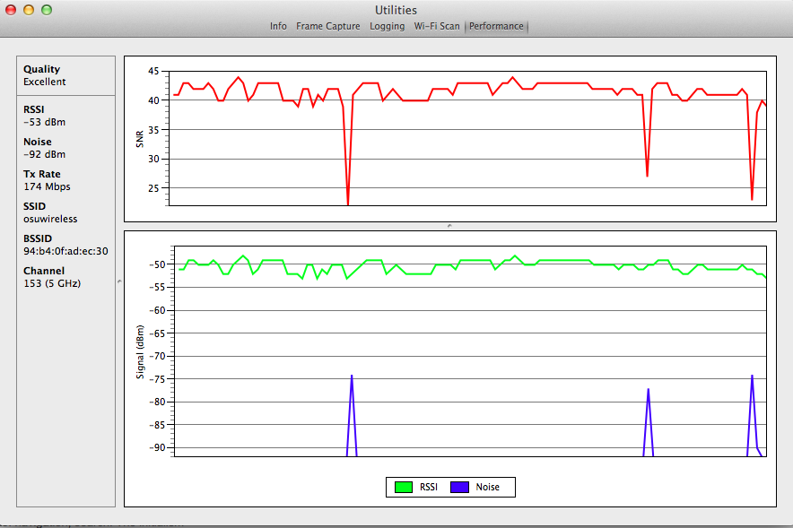
MAC built-in diagonostics
RSSI won’t change much in short time. But it varies within about +-3dBm.
SNR - signal to noise ratio
RSSI;Noise
18 ave 4 floor osuwireless
Statistics in 3 minutes

Slide 8
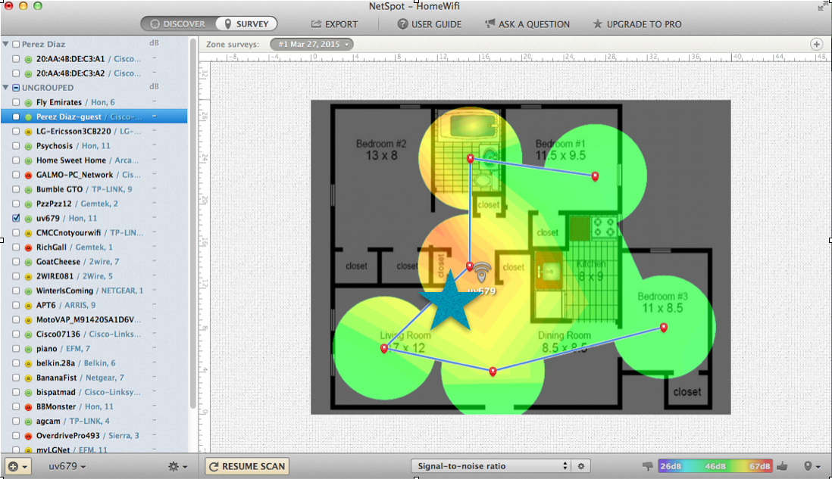
NetSpot
Home, check if strongest rssi is where ap locates.

Slide 9
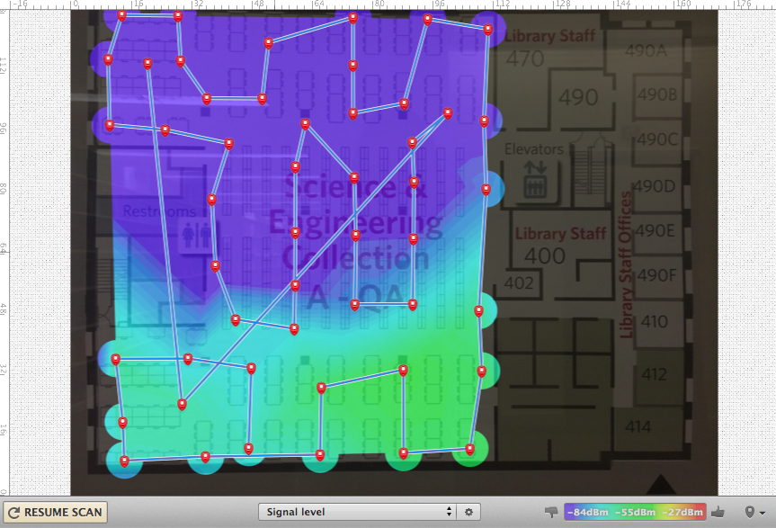
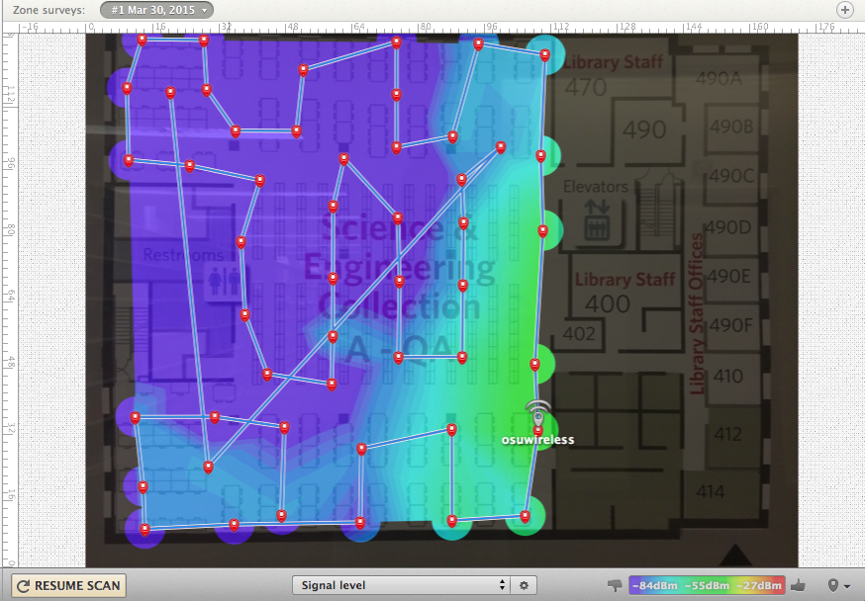
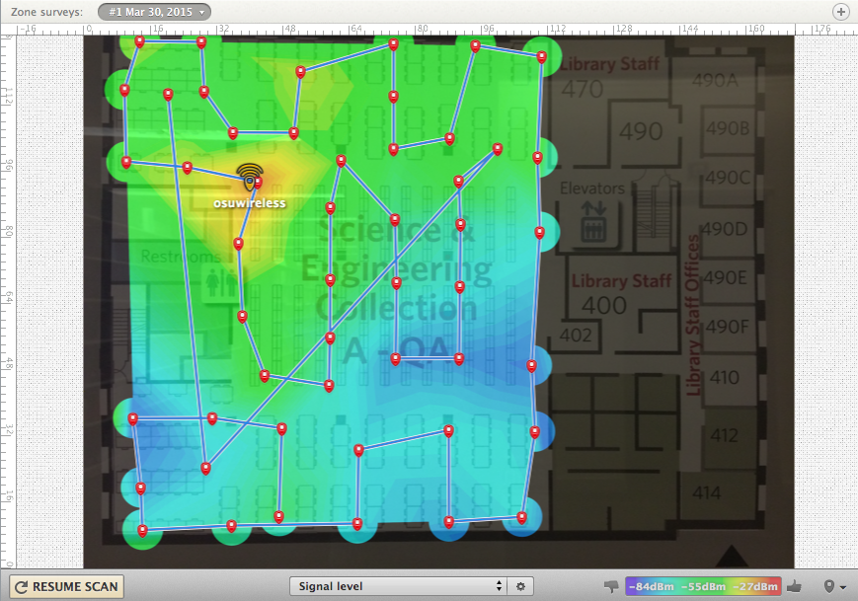
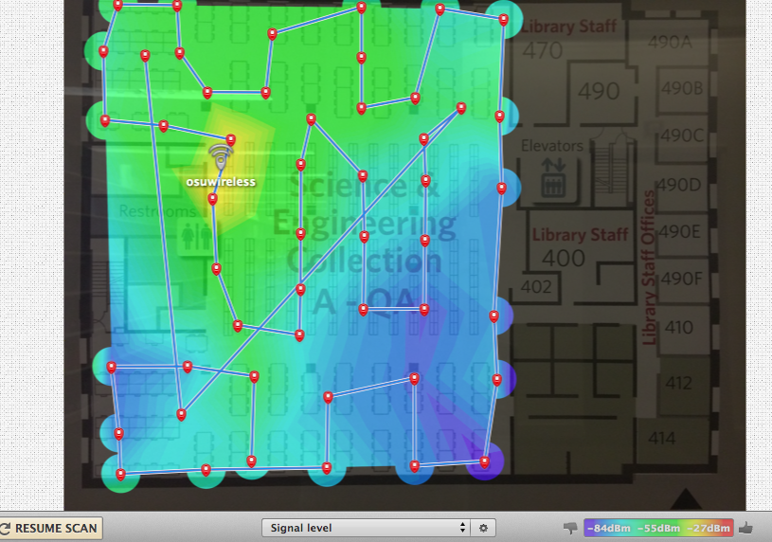
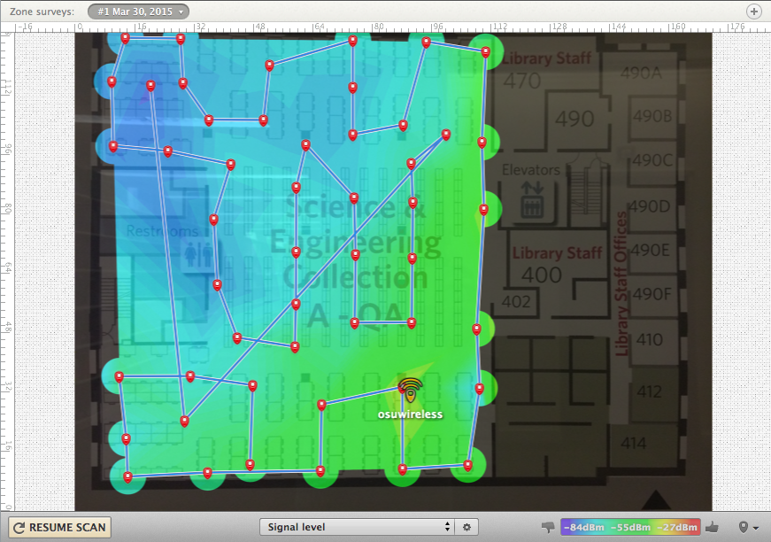
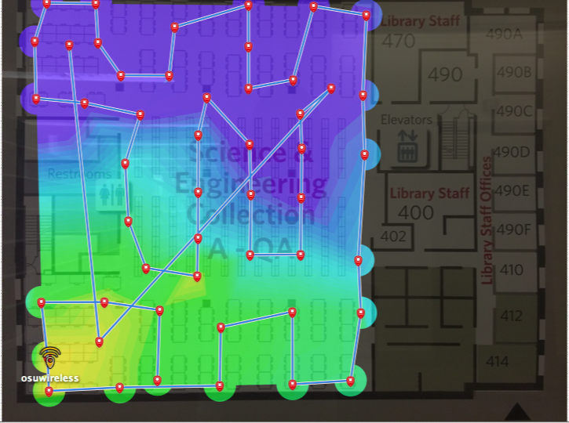
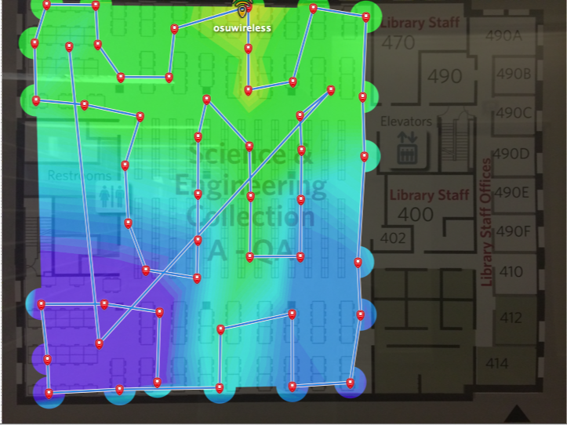
MEASUREMENT RSSI

Slide 10
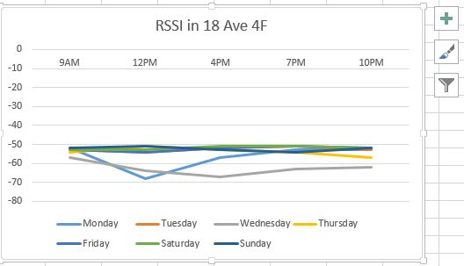
Fixed location and access point.

Slide 11
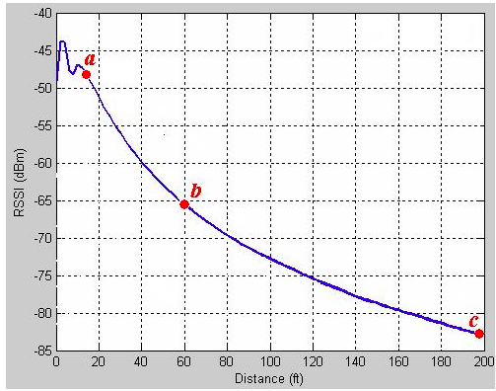
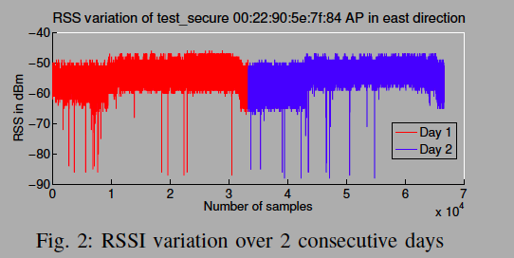
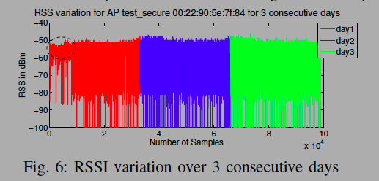
Comparison result
Influence Parameters:
Hardware: Orientation, directionality and type of antenna (WLAN card)
Spatial: Distance between receiver and transmitter (AP)
Temporal: Time and period of measurement
Interference: RF interference due to nearby devices operating is same/different radio channel
Human: User’s presence/absence, orientation, mobility
Environment: Building types, materials
References:
Chapre, Yogita, et al. "Received signal strength indicator and its analysis in a typical WLAN system (short paper)." Local Computer Networks (LCN), 2013 IEEE 38th Conference on. IEEE, 2013.
http://www.cisco.com/c/en/us/td/docs/solutions/Enterprise/Mobility/WiFiLBS-DG/wifich5.html

Slide 12
Packet Loss Rate
ping
WireShark
iPerf

Slide 13
Ping
Ping operates by sending Internet Control Message Protocol (ICMP) echo request packets to the target host and waiting for an ICMP response. In the process it measures the time from transmission to reception (round-trip time) and records any packet loss.

Slide 14
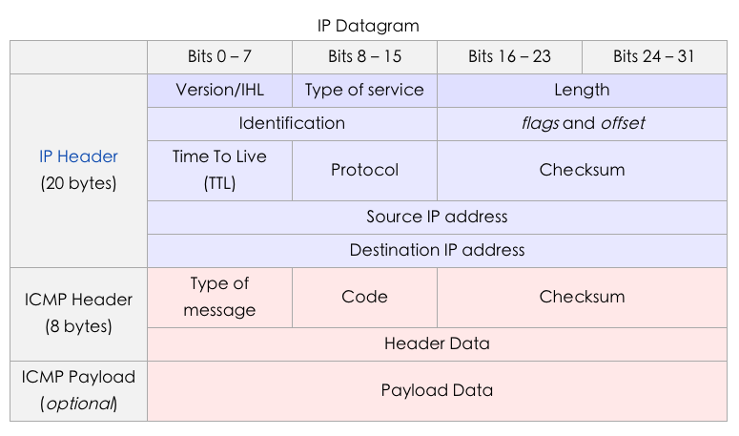

Slide 15
Packet Loss Rate
ping
WireShark
iPerf

Slide 16
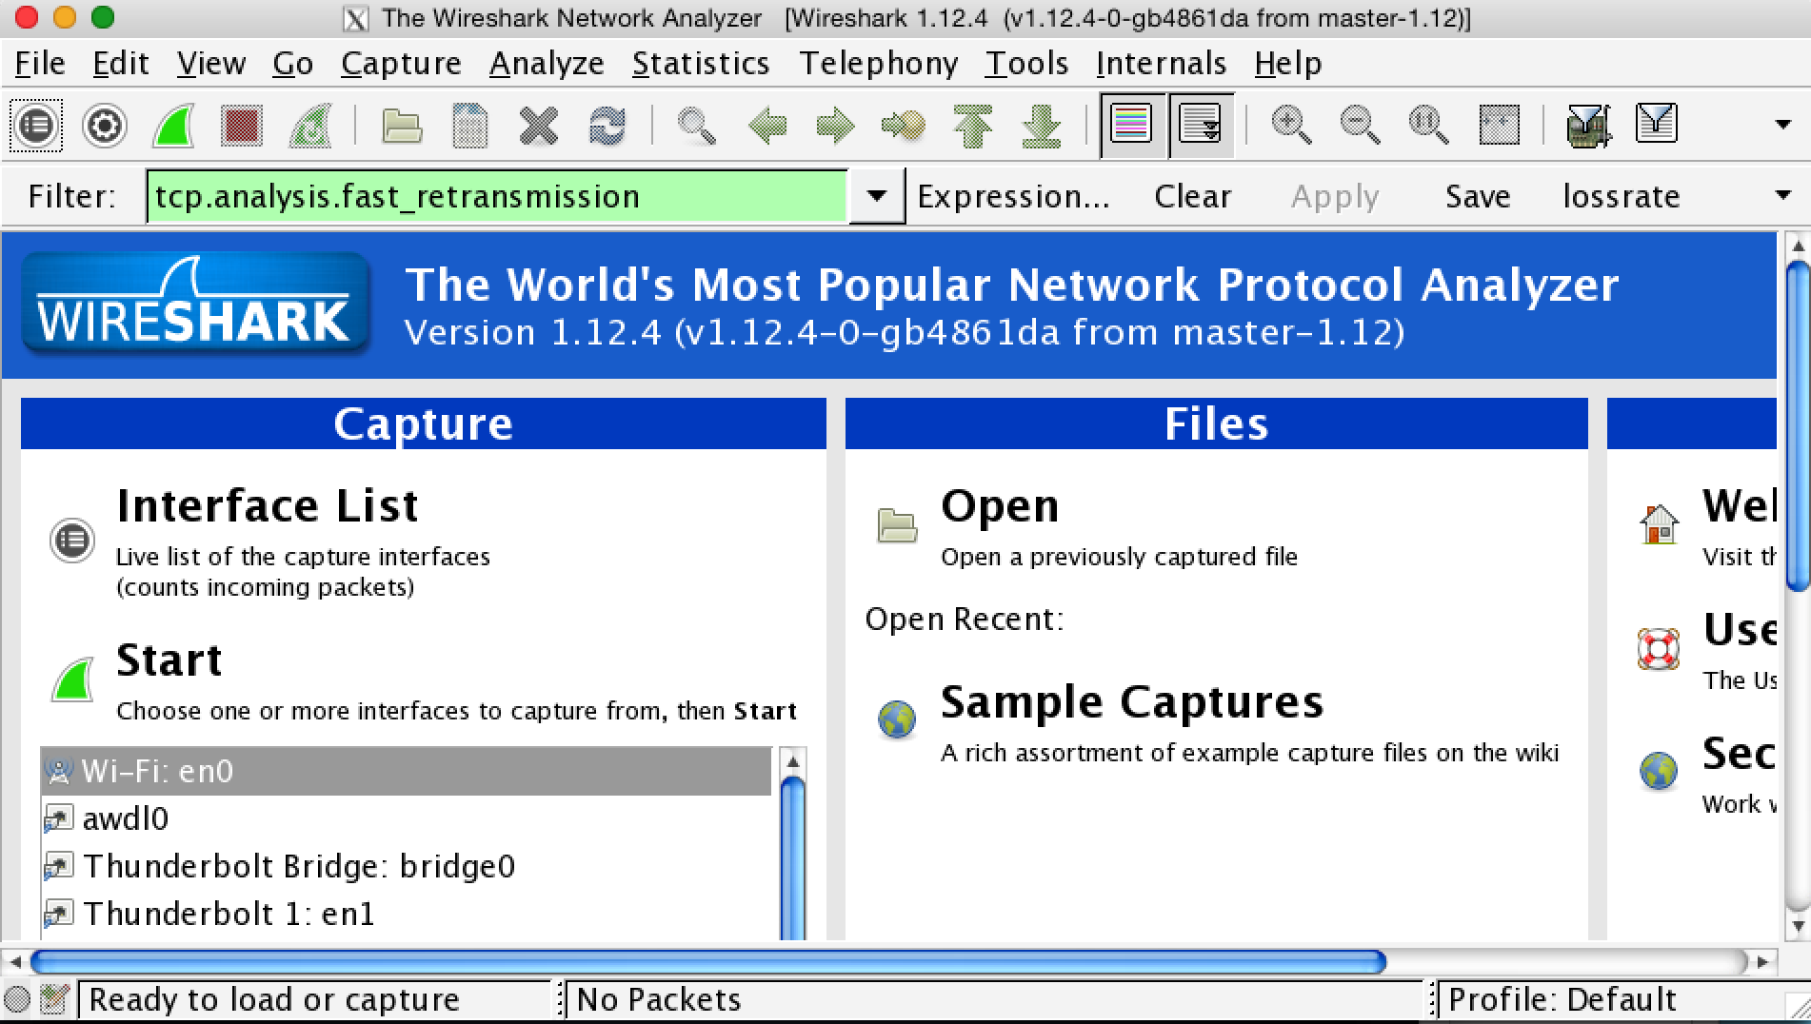
Wireshark

Slide 17
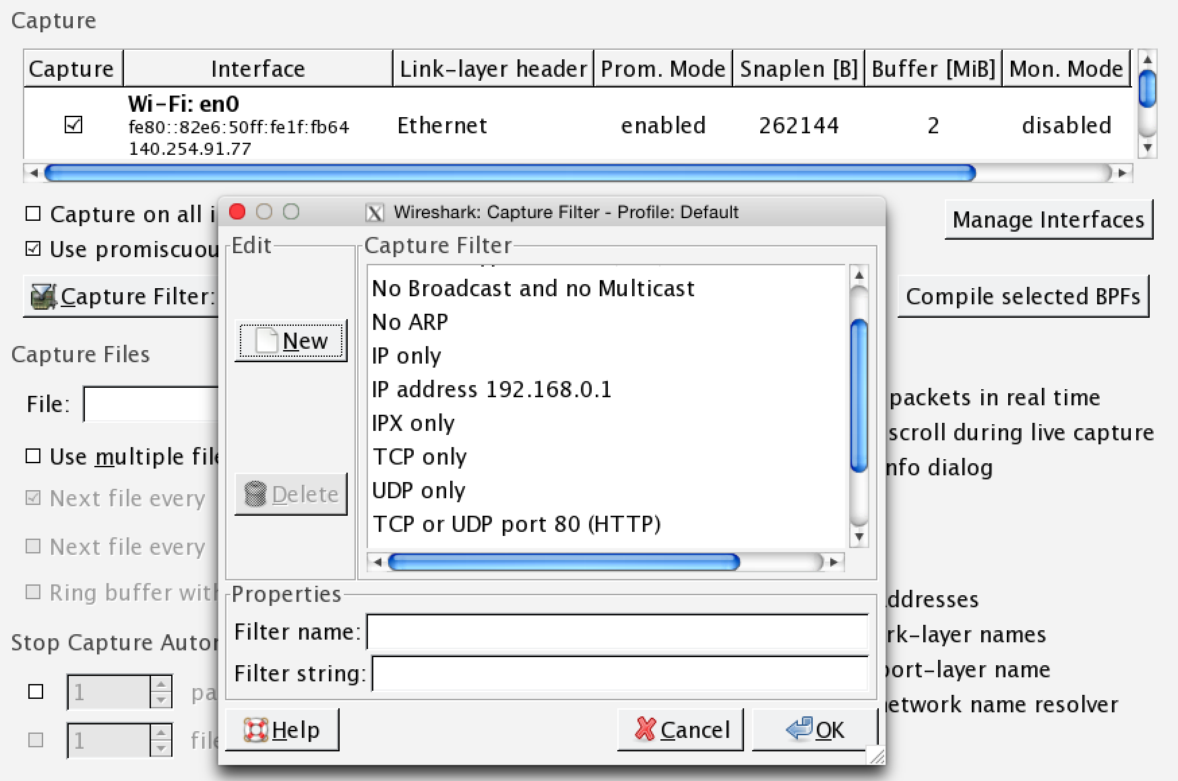
Wireshark

Slide 18
Wireshark
Problems

Slide 19
Packet Loss Rate
ping
WireShark
iPerf

Slide 20
Iperf
Iperf is a tool to measure the bandwidth and the quality of a network link.
The network link is delimited by two hosts running Iperf.
The quality of a link can be tested as follows:
- Latency (response time or RTT): can be measured with the Ping command.
- Jitter (latency variation): can be measured with an Iperf UDP test.
- Datagram loss: can be measured with an Iperf UDP test.

Slide 21
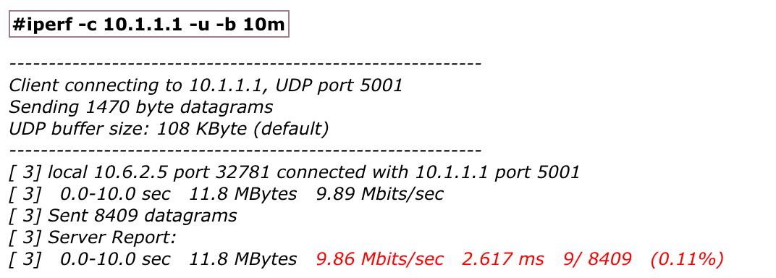
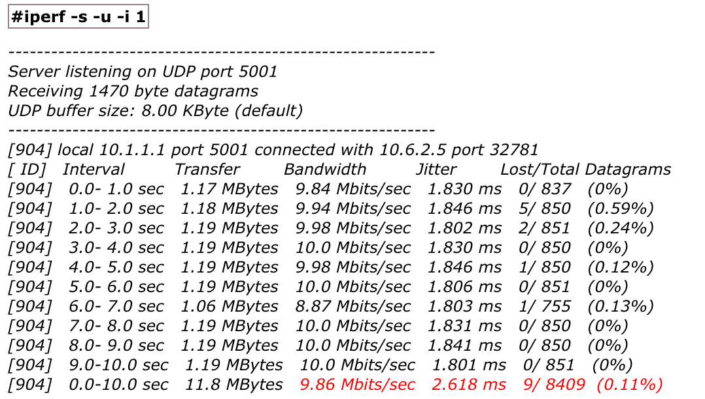
Iperf

Slide 22
Iperf
Problems

Slide 23
Packet loss parameters
Packet size
Distance/RSSI
Packet interval
Hardware

Slide 24
Packet lossrate
Our test:
sudo ping -f -c 500000 [ip of connected router]
Test 5 times per hour and get mean of the 5

Slide 25
MEASUREMENT Packet Loss
Different time of a day
Different day of a week
Busy location vs non-busy location

Slide 26
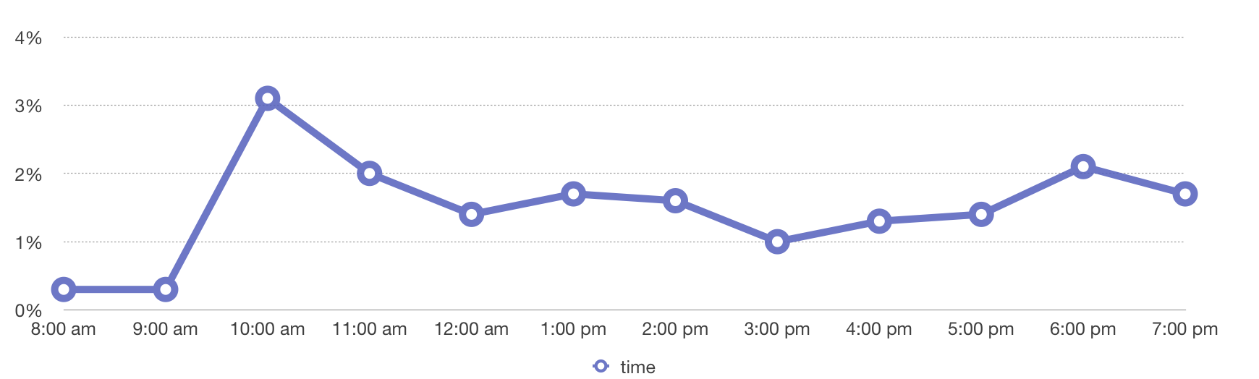
Packet loss rate, SEL, 03/25/2015

Slide 27
MEASUREMENT Packet Loss
Different time of a day
Different day of a week
Busy location vs non-busy location

Slide 28
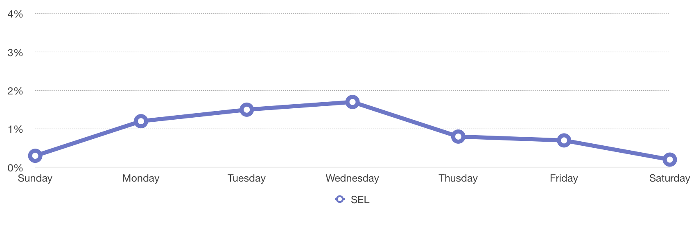
SEL, 03/22/2015 - 03/28/2015

Slide 29
MEASUREMENT Packet Loss
Different time of a day
Different day of a week
Busy location vs non-busy location

Slide 30
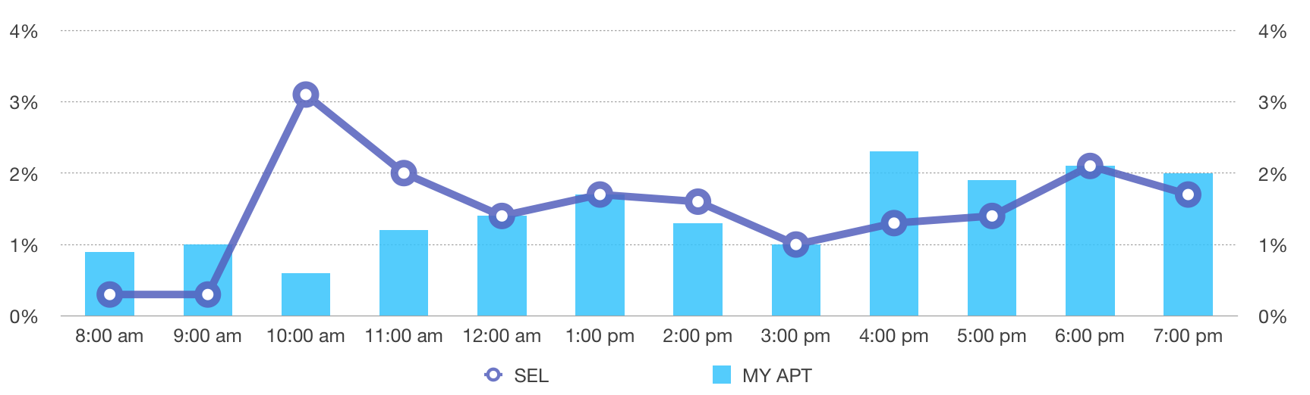
Compare with my apt on saturday

Slide 31
MEASUREMENT Packet Loss
Our observation:
1. ip changes when re-connect
2. ping duplicates?
3. use ping will be banned

